Slide 1

Mobile Homepage Design Slam
Presented by: Lacey kruger, Lead Information Architect
Michael Chang, Creative director
#bbinteractive
Notes:
TITLE SLIDE.

Slide 2
Mobile Strategy basics
Notes:
Section header

Slide 3
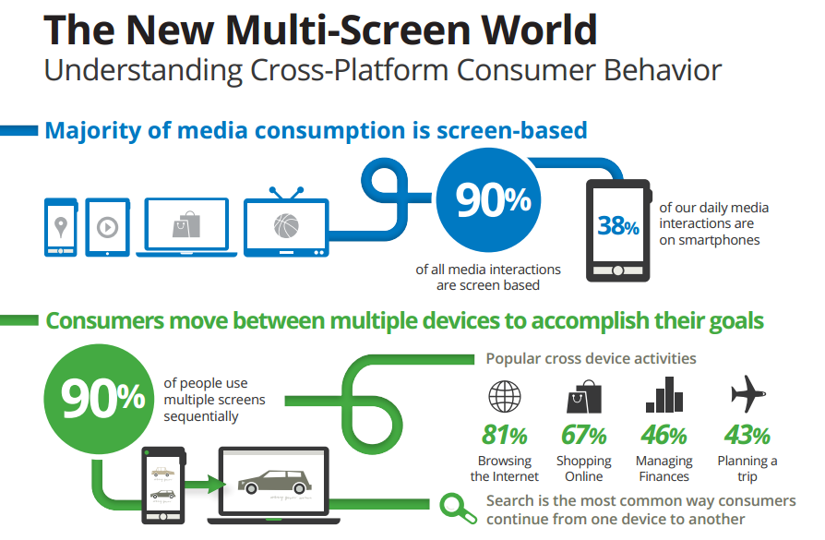
Why Do I need a Mobile Presence?
Broaden your reach
Redesigning your website
Your users are already there!
Source: Google/Ipsos/Sterling, 2012

Slide 4
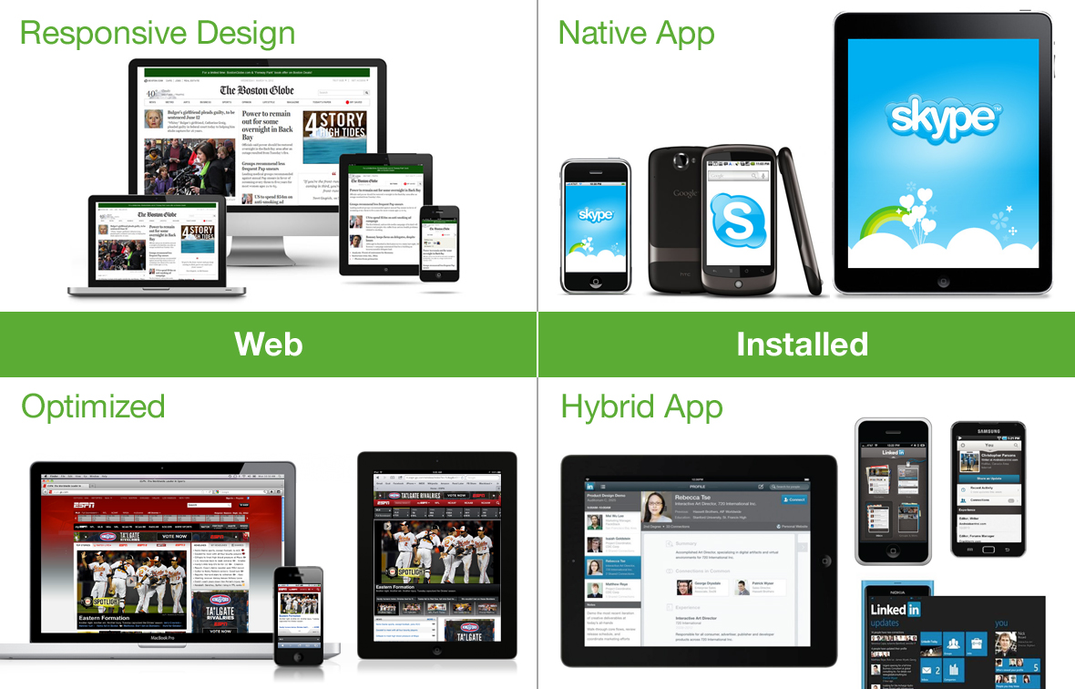
The Mobile landscape

Slide 5
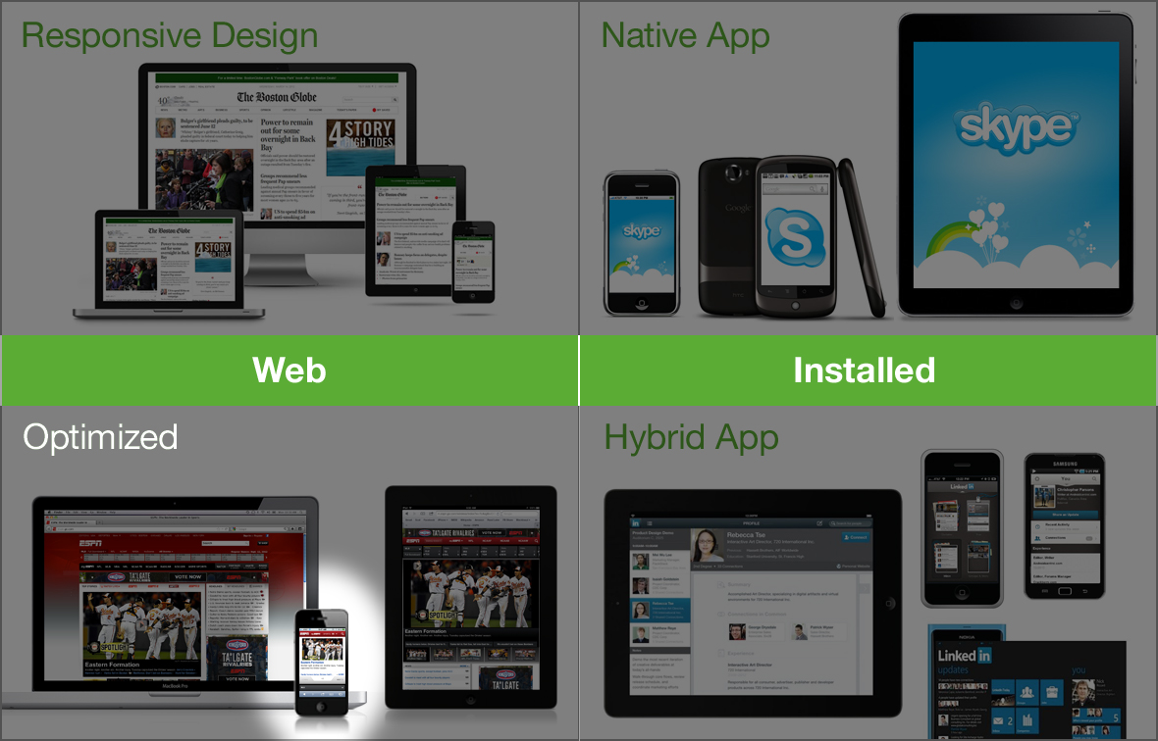
Focus on mobile optimized website

Slide 6
Mobile Optimized Websites
Can leverage your existing web presence
Can be designed/built relatively quickly
Can be the first step towards a Responsive Design
MOBILE FIRST

Slide 7
Design Process
Define one key message
Identify desired actions
Allocate real estate
Create design

Slide 8
Define One Key Message
This is not your mission statement
Must be succinct, understandable and repeatable
"At [org name] we [verb phrase] so that [constituent group] can [verb phrase].”

Slide 9
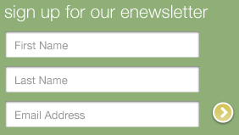
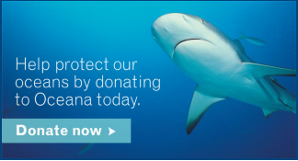
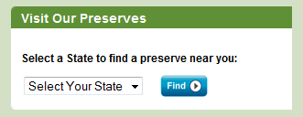
Identify Desired Actions
Ideally focus on 1-2 key actions
  No more than 5
Prioritize actions so one task is clearly at the forefront
Email signup
Donations
Other possible actions:
advocacy
social sharing
event registration
Location-specific search

Slide 10
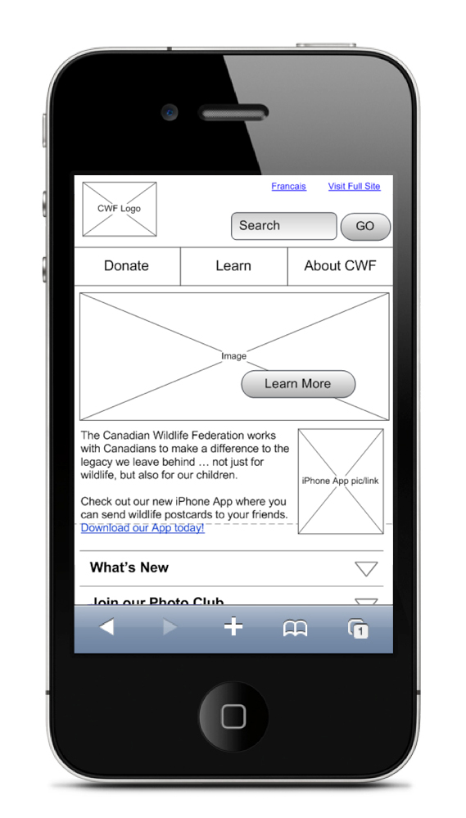
Allocate Real Estate
Start with key message and desired actions
Standard screen size: 320x480 pixels
Prioritize. And plan for experiences at top AND bottom of page
Limit scrolling for homepage, but OK for secondary pages

Slide 11
Create Design
SIMPLY SIMPLY SIMPLIFY SIMPLIFY SIMPLIFY
Think touch (fingertip ~ 44x44 px)
Maintain consistent links, buttons, CTAs
Be consistent with the online and offline drivers
Design to decrease page load times, optimize graphics for fastest load
If designing in Photoshop, suggest use 144dpi
    Give coders more pixels to work with
    Prep for Retina displays
Rely on established design patterns* and interactions
*Will introduce after examples.

Slide 12
Examples

Slide 13

UNICEF

Slide 14
UNICEF

Slide 15
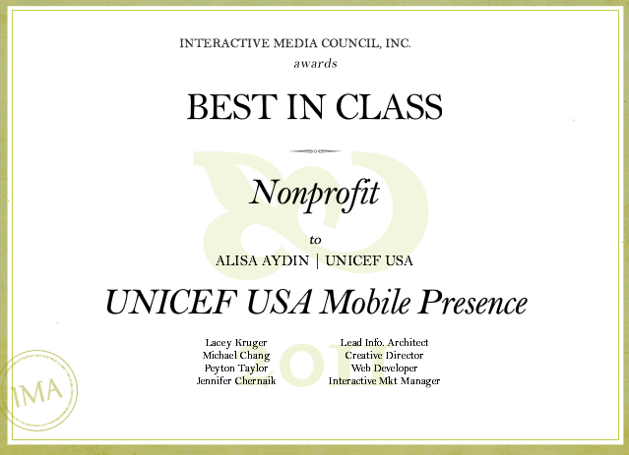
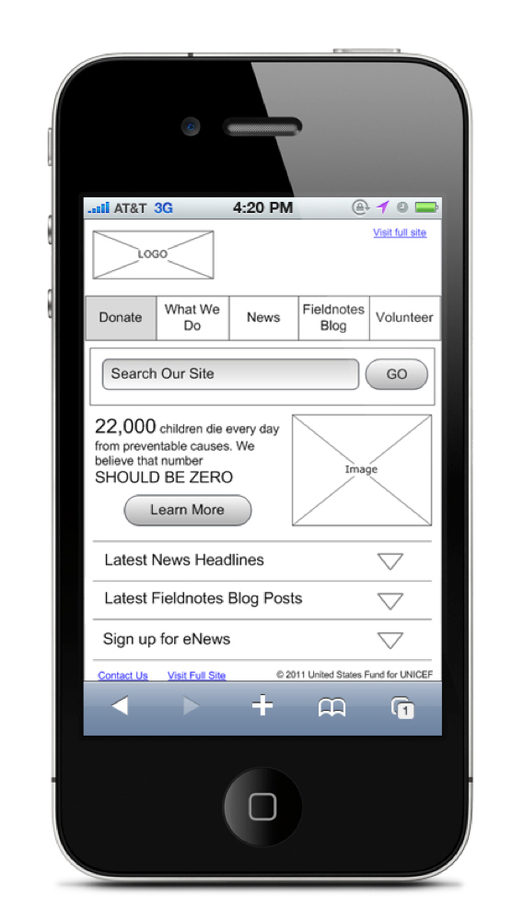
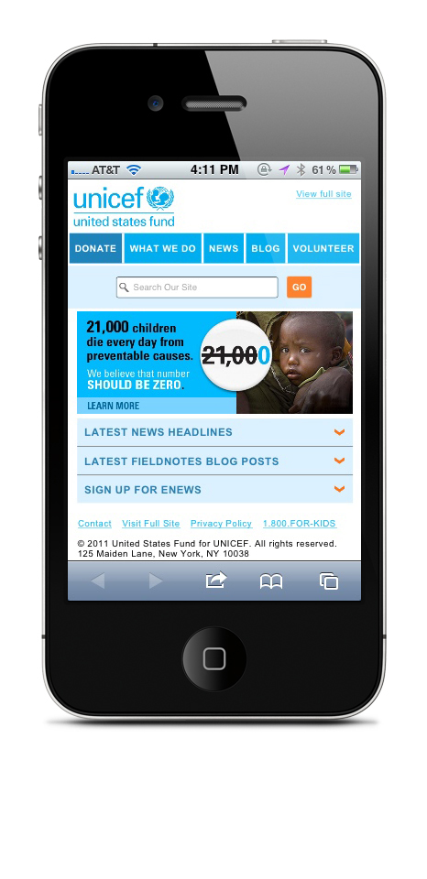
UNICEF

Slide 16
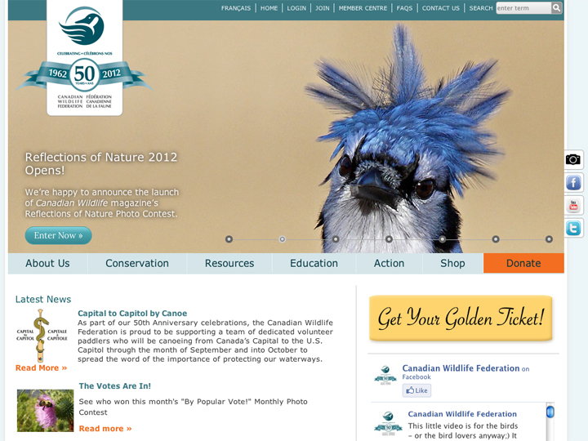
UNICEF

Slide 17
UNICEF

Slide 18
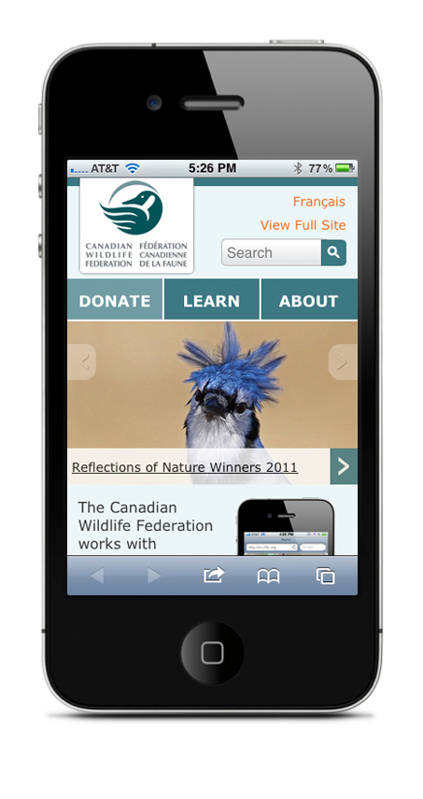
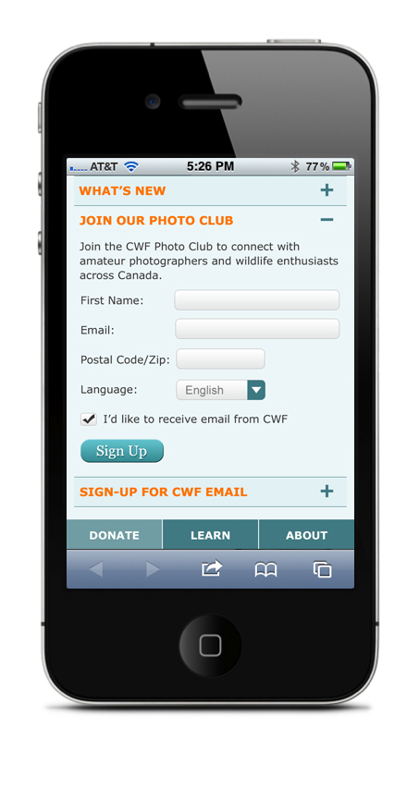
Canadian wildlife federation

Slide 19
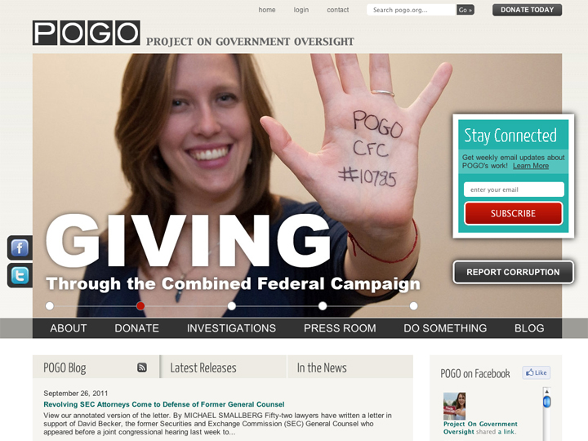
UNICEF

Slide 20
UNICEF

Slide 21
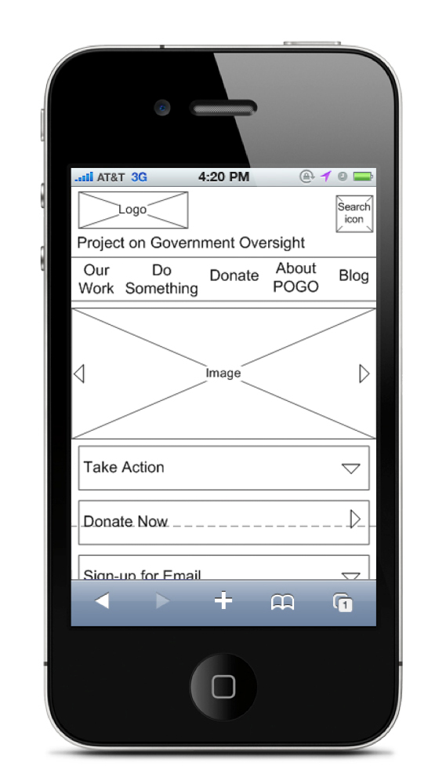
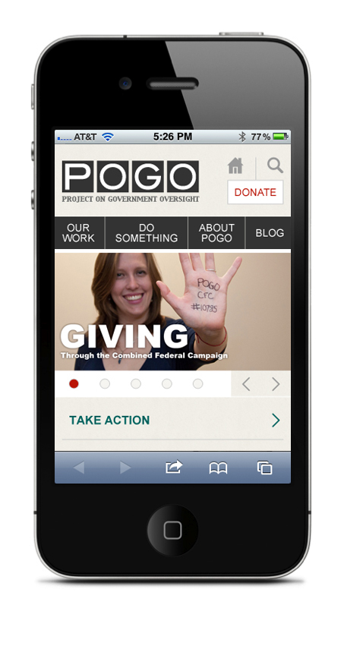
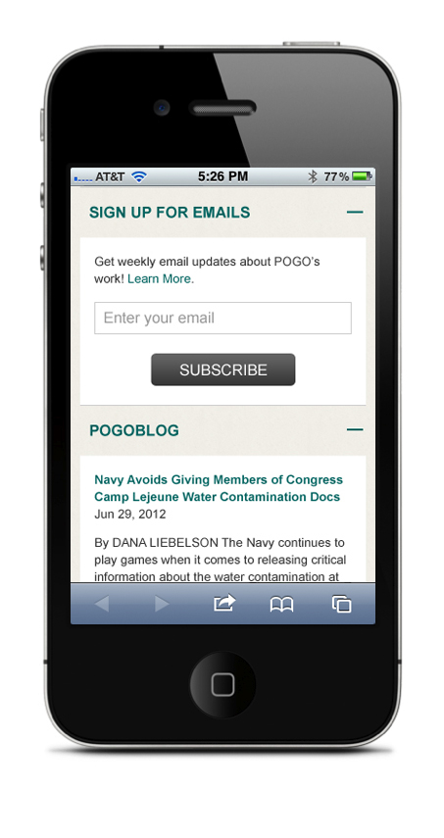
Project on government oversight

Slide 22
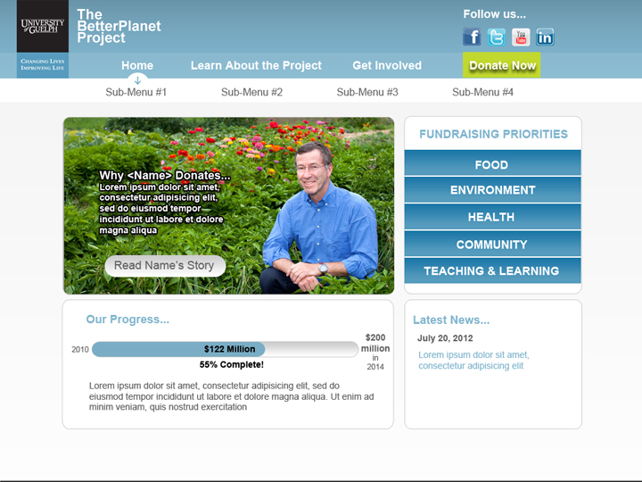
UNICEF

Slide 23
UNICEF

Slide 24
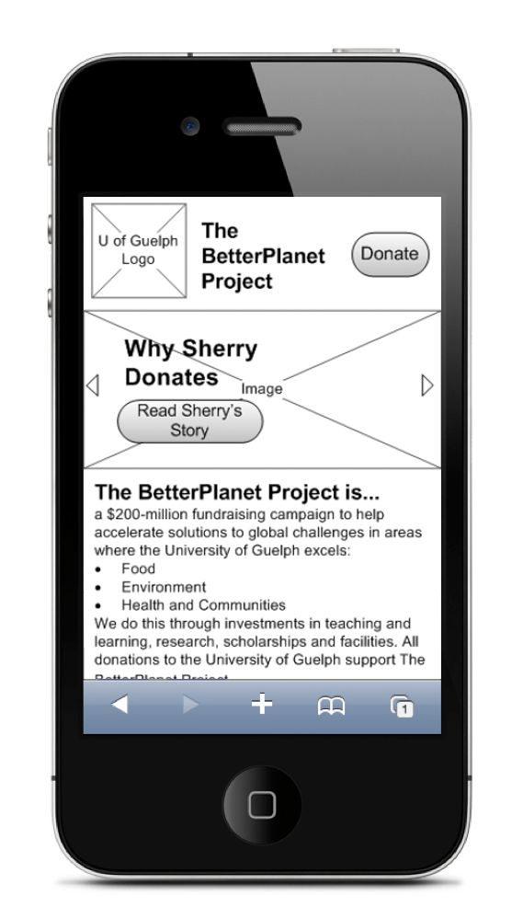
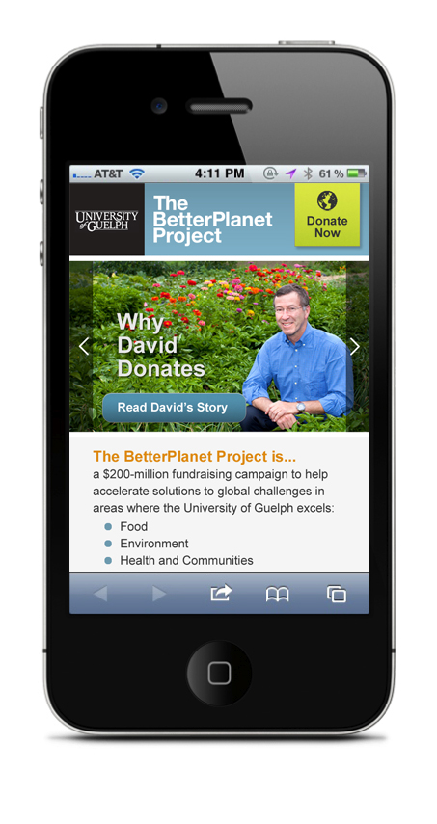
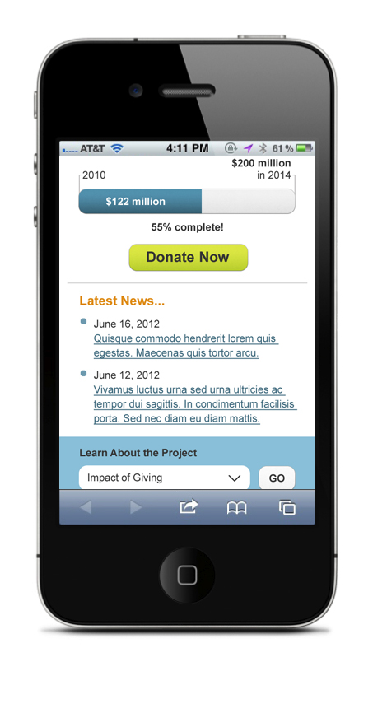
University microsite

Slide 25

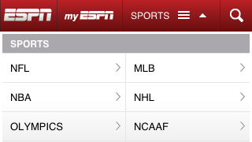
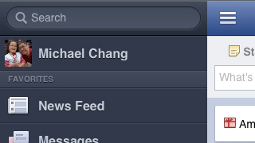
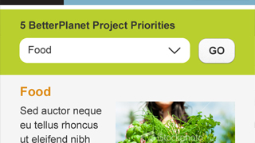
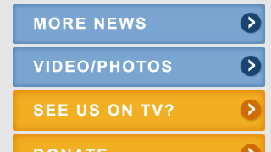
Design patterns :: Navigation
Top Nav
The Toggle
Left Nav Flyout
Select Menu
List Menu
Based on Brad Frost's list of responsive design nav patterns

Slide 26
Volunteers for design slam
Please be nice and respectful…

Slide 27


Resources
Use UI stencils and design starters: keynotopia.com, teehanlax.com
Make it interactive: jquerymobile.com
Get inspired: mobileawesomeness.com
Read up:
    “Mobile Design Pattern Gallery” by Theresa Neil (app focused)
    “Mobile First” by Luke Wroblewski

